Slide 1
Bias and Variance Tradeoff
Chris Kuo, Ph.D.| Columbia University

Slide 2
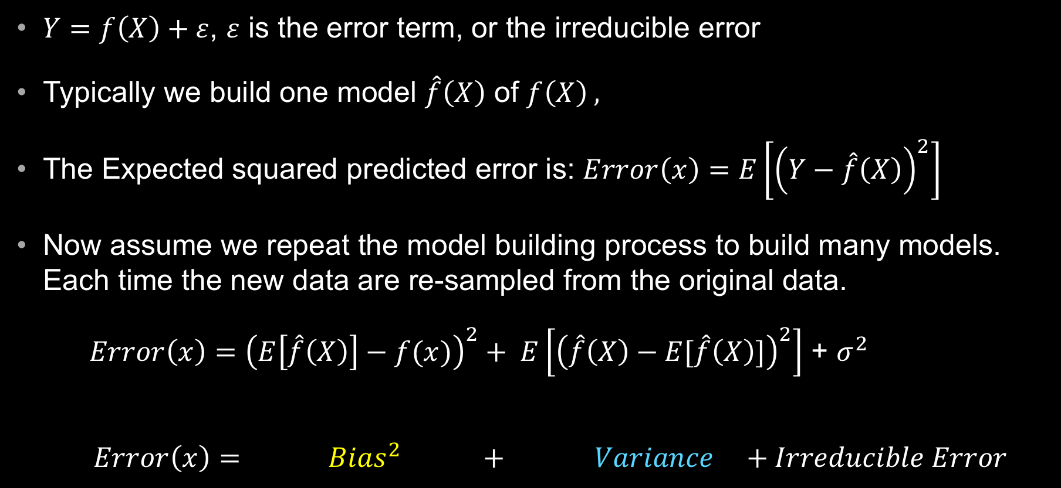
Bias vs. Variance
$Y=f\left(X\right)+ε$, $ε$ is the error term, or the irreducible error
Typically we build one model $\hat{f}\left(X\right)$ of $f\left(X\right) ,$
The Expected squared predicted error is: $Error\left(x\right)=E\left[{\left(Y−\hat{f}\left(X\right)\right)}^{2}\right]$
Now assume we repeat the model building process to build many models. Each time the new data are re-sampled from the original data.
$Error\left(x\right)={\left(E\left[\hat{f}\left(X\right)\right]−f(x)\right)}^{2}+ E\left[{\left(\hat{f}\left(X\right)−E[\hat{f}\left(X\right)]\right)}^{2}\right]$ + $σ^{2}$
$$Error\left(x\right)= { Bias}^{2} + Variance +Irreducible Error$$

Slide 3
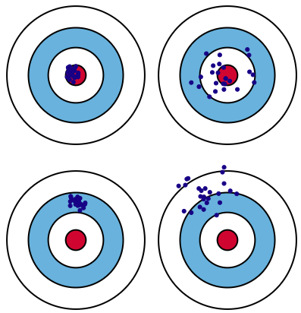
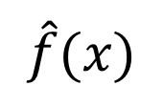
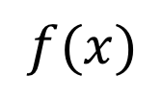
Low Variance
High Variance
Low Bias
$$\hat{f}(x)$$
Variance
Bias
High Bias
$$f(x)$$

Slide 4
Bias vs. Variance

Slide 5
Overfitting -- Fit a particular dataset too well and lose the generality to other new data

